Slide 1

[Samsung PRISM] End Review Report
Smart Containers
Working Team Details [Name & Email ID] :
College Professor(s): Kamlesh Kukreti (Kamleshkukreti.ece@geu.ac.in)
Students:
Rishav Raj Chaudhary (rishavraj.cse190111364.gehu.ac.in)
Rahul Walia (rahulwalia.cse190111094@gehu.ac.in)
Department: Computer Science
Date: 30 Mar 2019

Slide 2
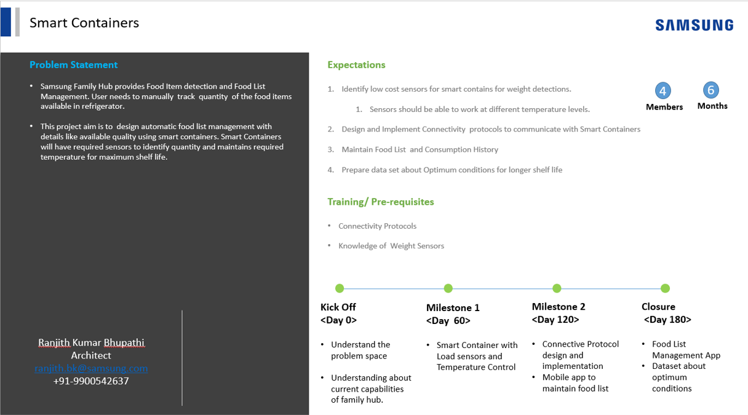

Slide 3
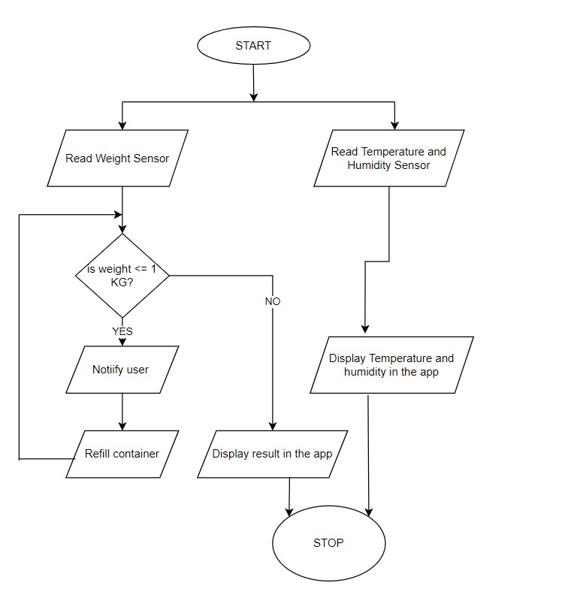
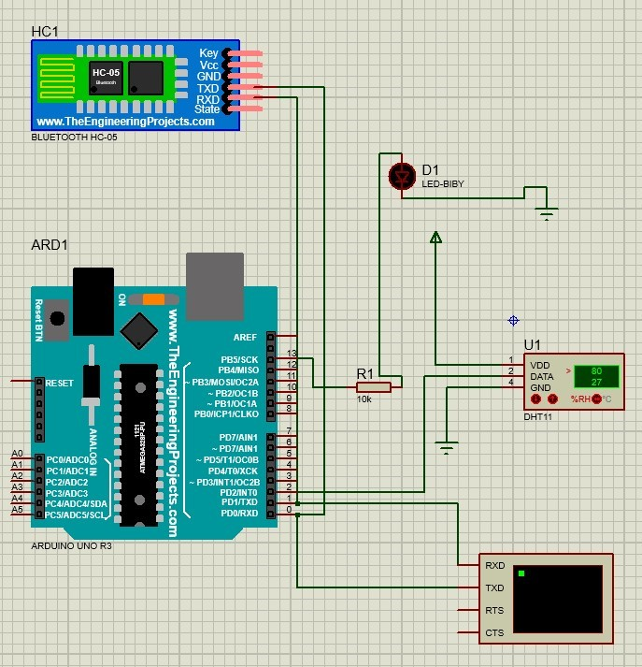
Approach / Solution
Concept Diagram :
Fig - Smart Containers flowchart

Slide 4
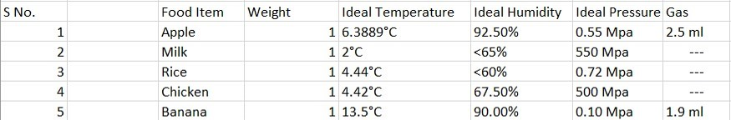
Dataset(s) Analysis / Description
Dataset Capture / Preparation / Generation :
Normal day-day edible food items.
Edible and non-edible conditions with respect to the environment.
Observation based on Kaggle datasets.
Dataset Understanding / Analysis :
Average value is taken for the observation.
Decision-based on calculated values can be made.
Reliable.
Dataset Pre-Processing / Related Challenges (if any) :
Redundancy based on same food item’s data.
Too much data for the same food item.
Null values for some data items.

Slide 5
Experimental Results / Simulations / Observations
Results :
we established a connection between the app and the container
Below is the google drive link for the demonstration of the project :
https://drive.google.com/file/d/1-spkLI8AEqD1ih3HjB02kZSZatBcLudK/view?usp=sharing
Major Observations / Conclusions & Challenges :
Detected weight, temperature, pressure, humidity, etc. for food items.
Sensors are able to work at different levels.
Maintained food list and consumption history.
Prepared dataset about optimum conditions for longer shelf life.

Slide 6
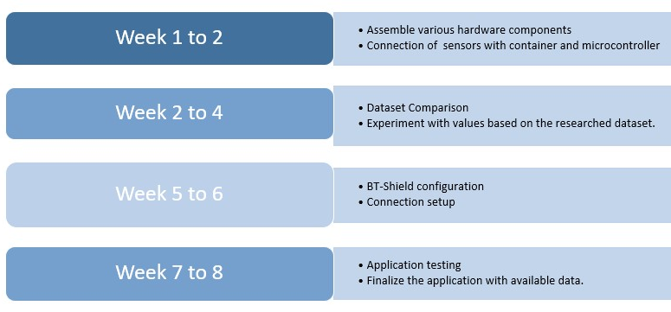
Deliverable
Final Deliverables :
Experimental verification with actual hardware components.
Delivered actual end-end communication between container device and user’s application.
Stable Connection between the container and mobile application via Bluetooth.
Robust dataset.
IP / Paper Publication Plan :
We can record the food item with respect to the day of entry and notify the user whenever the food expires or crosses the expected date of consumption.
We can make use of machine learning to track down health-related data.
KPIs delivered/Expectations Met:
Created successful connection between the
container and mobile app via Bluetooth.
Finalized the application with available data.

Slide 7
Work-let Closure Details
Code Upload details:
Items | Details
KLOC (Number OF Lines of codes in 000’s) | 580
Model and Algorithm details | Linear model to trace and manipulate data.
Is Mid review, end review report uploaded on Git ? | YES
Link for Git | https://github.ecodesamsung.com/rishavraj-cse190111364/Documents
Data details (if applicable):
Items | Data folder 1 | Data folder 2 | Data Folder 3……..
Name & Type of Data (Audio/Image/Video) | Video
Number of data points | 25
Source of Data (self collected, Scrapped, available on open source) | Self-collected
Google drive link/ git link to access data | https://drive.google.com/file/d/1nEmY9WE6UZMk7y4HfZK8kNFs7w9Qogzz/view?usp=sharing

Slide 8
Thank you

